Slide 1
BIC-induced SHG

Slide 2
Figure 1

Slide 3
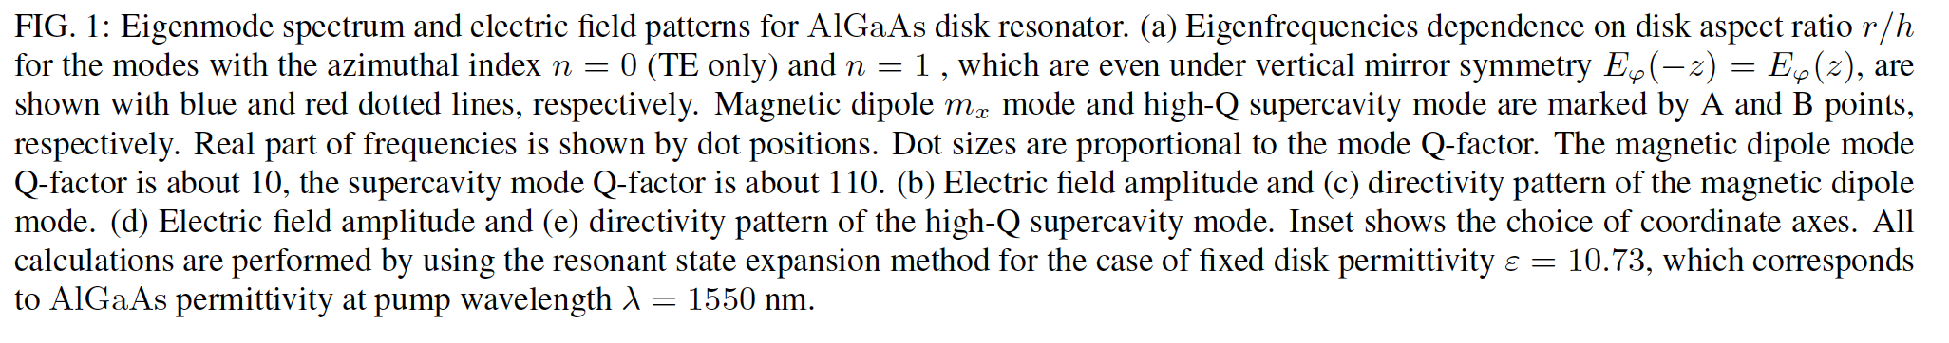
Figure 2

Slide 4
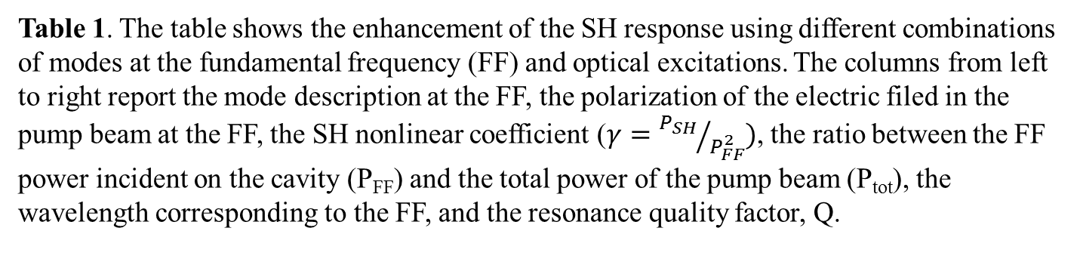
Mode FF | Polarization | γ × 10² (W⁻¹) | P_{FF}/P_{tot} | λ_{FF} (μm) | Q
BIC | Azimuthal | 123 | 0.048 | 1.55 | 114
BIC | Linear | 1 | 0.232 | 1.55 | 114
MD | Linear | 1.3 | 0.086 | 2.98 | 10
Table 1. The table shows the enhancement of the SH response using different combinations of modes at the fundamental frequency (FF) and optical excitations. The columns from left to right report the mode description at the FF, the polarization of the electric filed in the pump beam at the FF, the SH nonlinear coefficient ($γ={P_{SH}}/{P_{FF}^{2}})$, the ratio between the FF power incident on the cavity (P_{FF}) and the total power of the pump beam (P_{tot}), the wavelength corresponding to the FF, and the resonance quality factor, Q.

Slide 5
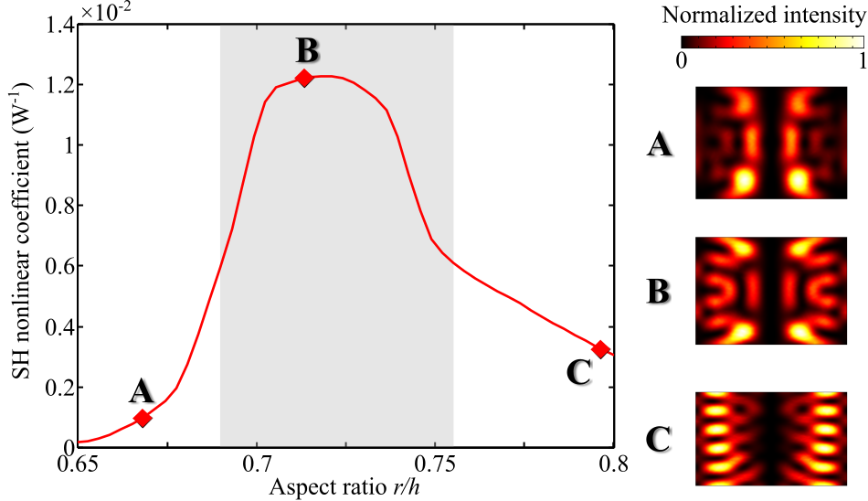
Figure 4
Figure 3. SH nonlinear coefficient as a function of the disk aspect ratio (r/h). The record-high value for magnetic dipole excitation is indicated by the black dashed line. Intensity mode profiles at the SH frequency in a longitudinal disk cross-section for aspect ratios of 0.675 (A), 0.71 (B), and 0.79 (C) are shown.

Slide 6
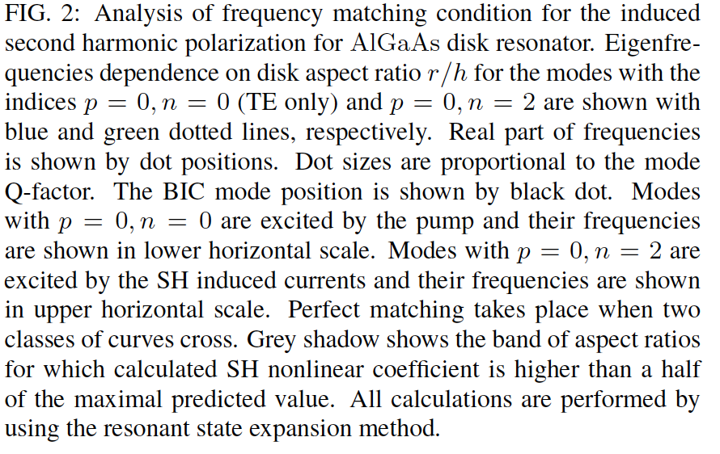
Figure 4

